Slide 1
Pre-Live Session
Multivariate Time Series

Slide 2
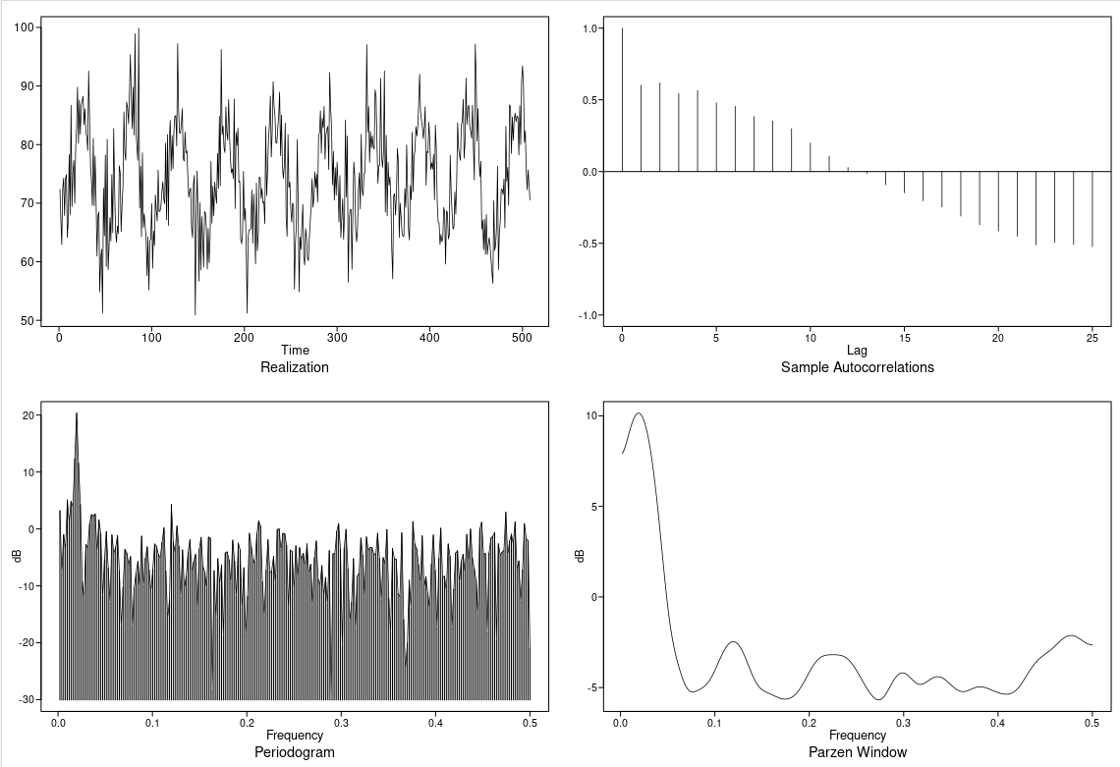
Cardiac Mortality
All 3 columns temperature and particle has a peak at 0.019685039. We will model a difference at period of 51 and also since var has a seasonal parameter we would also compare that with the differenced.

Slide 3
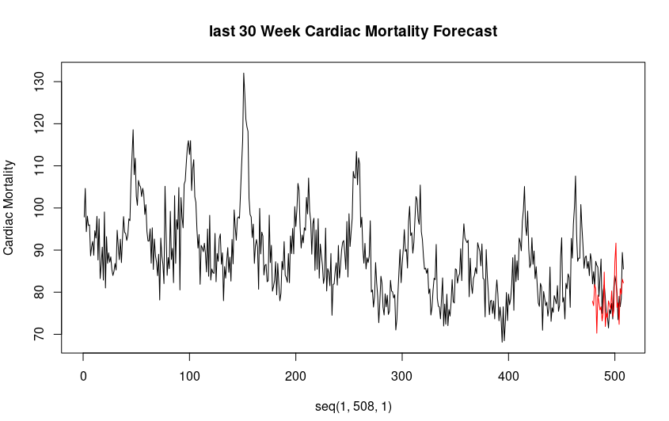
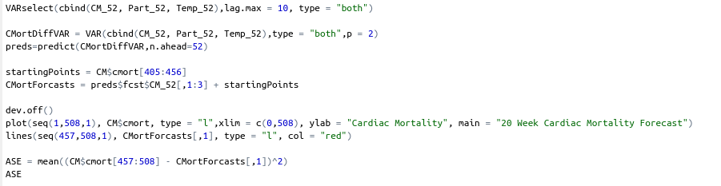
Cardiac Mortality Differenced
We use the difference data with var. The ASE with n.ahead of 30 is 34.32

Slide 4
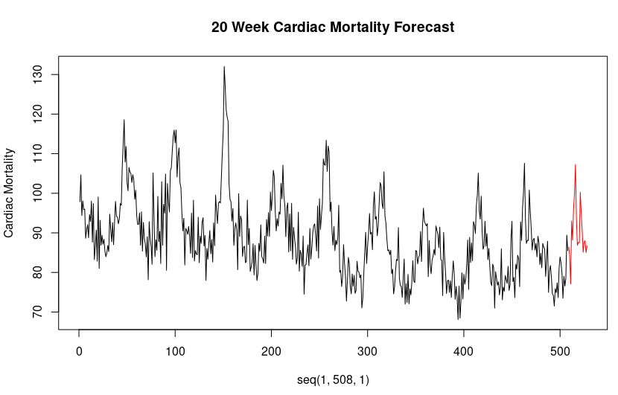
Differenced forecast

Slide 5

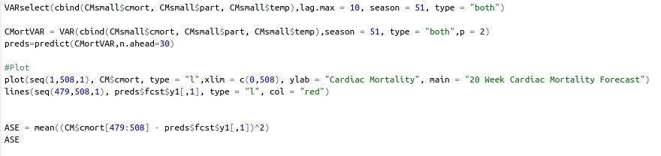
Cardiac Mortality
VAR without differencing. We use the var with parameter of seasonal and we set that to 51. The forecast slightly better than when they were differenced. The ASE with n.ahead of 30 is 32.54.

Slide 6
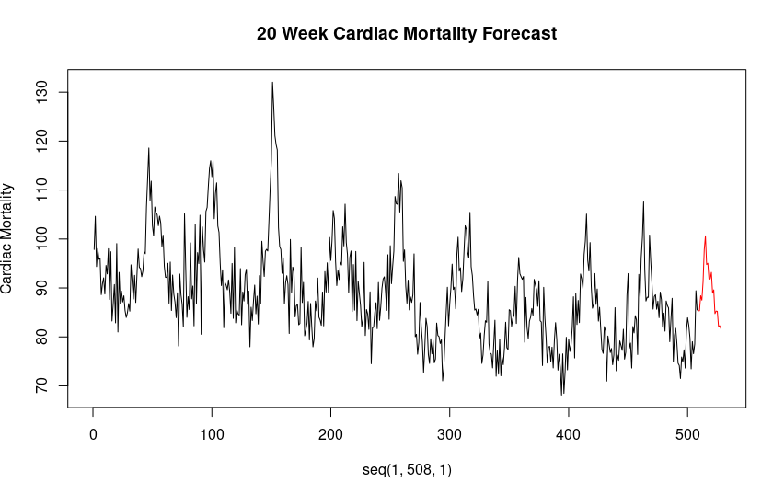
Seasonal Var Forecast

Slide 7
Takeaways
VARS is a good package building models with respect to autocorrelation between features involved and there relationship with respect to different lags provided. It shows which lag is most associated with each of the variables involved.
The ccf() function can also show the relationship between lags of 2 variables.
Examining the lags of a variable can explain a predictor variable better especially if we know that there is a delayed relationship between the 2 variables.

